Slide 1

Data Science Final Project
Eden Meshulam Daniel George

Slide 2
Topics:
About our project
Data acquisition
EDA
Machine learning

Slide 3
About our project :
Our project name is Winners , in our project we wanted to check if by based on data from the past we can predict the football team that are going to win in the next game. On our project we used the tools we’ve been told in the lectures. For example, crawling, visualizations and machine learning.

Slide 4
Data acquisition
1.Crawled every “La-liga” (The Spanish league name) games result from season 2000-2001 until the current season.
2. Stored the data in lists and created the data frame based on the lists.
3. Order our new data frame and make some more columns using our data

Slide 5
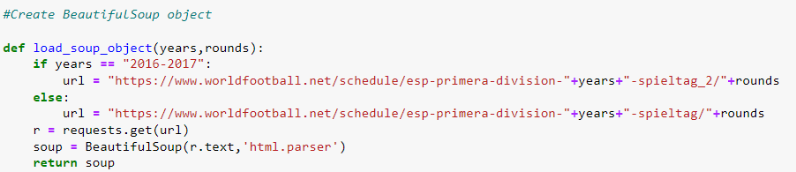
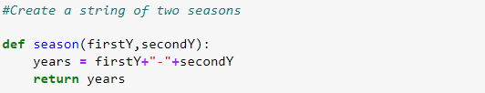
Crawled the data
Load the data from the website to BeutifulSoup object
Combine two years (football seasons start at one year and end on another )

Slide 6
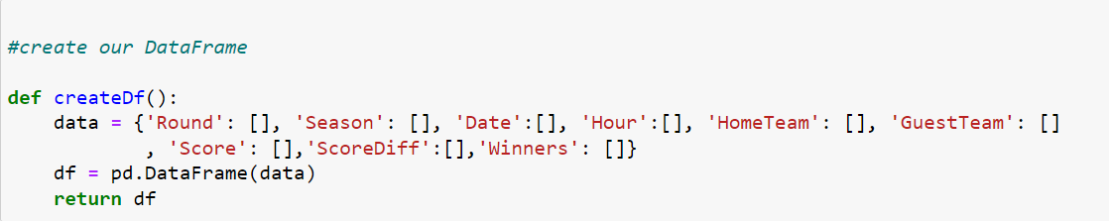
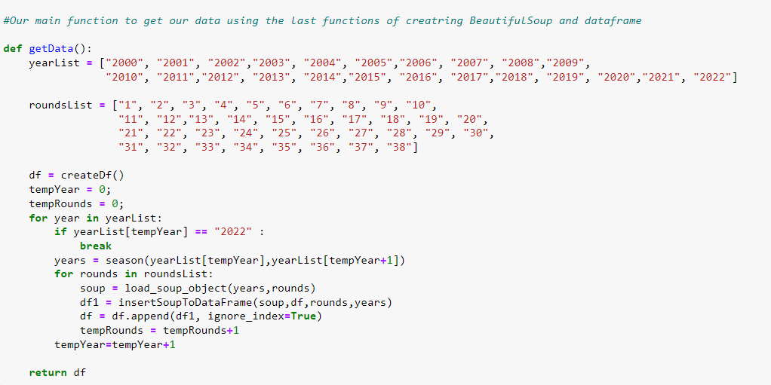
Create data frame

Slide 7
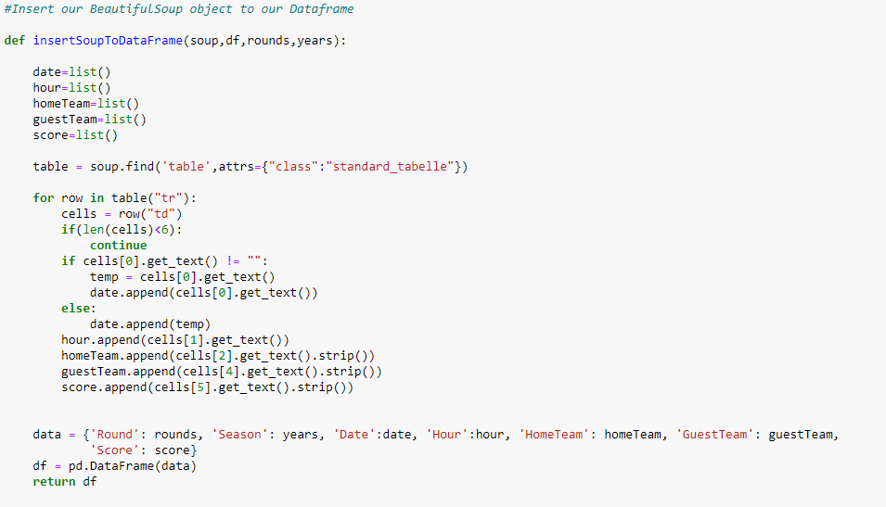
Stored the data in the data frame

Slide 8
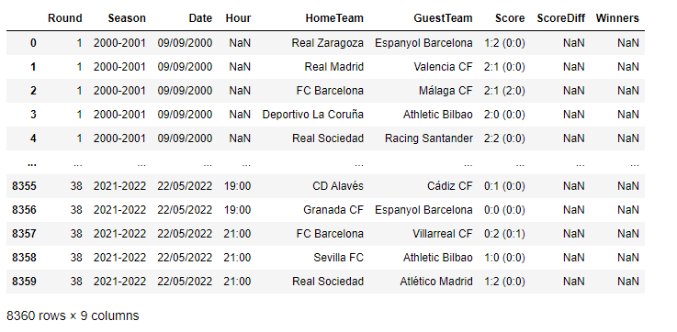
Data frame preprocessing :

Slide 9
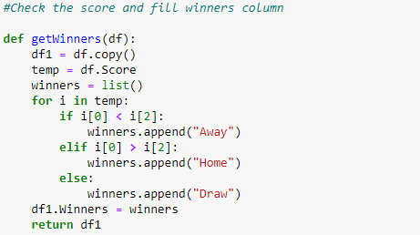

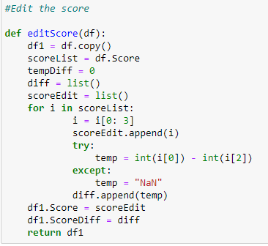
Clear some data and add some information

Slide 10
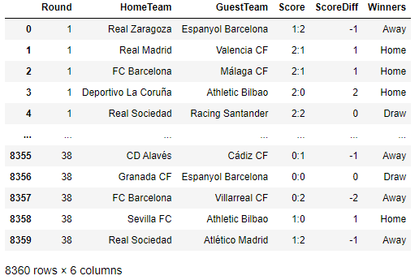
Data frame after processing :

Slide 11

Exploratory Data Analysis

Slide 12
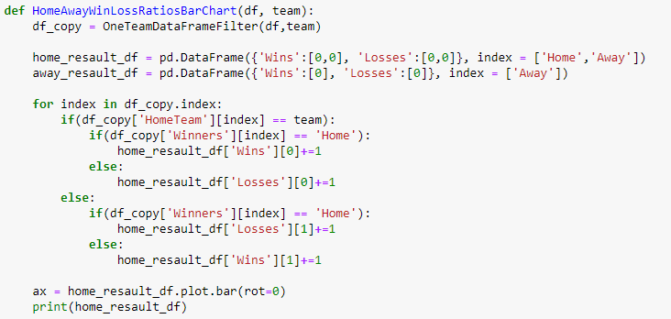
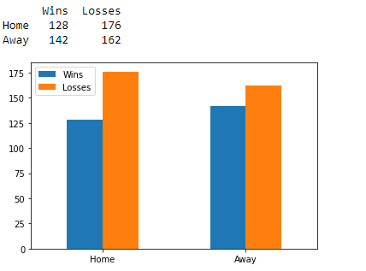
One team – win / loss ratio

Slide 13
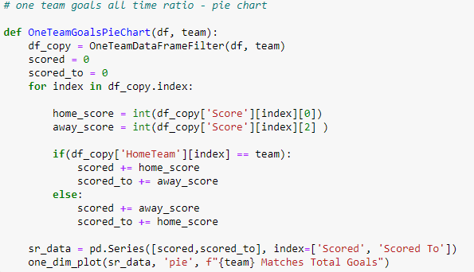
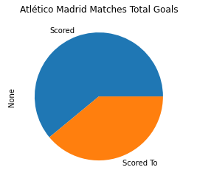
One team – goals scored to / scored ratio

Slide 14
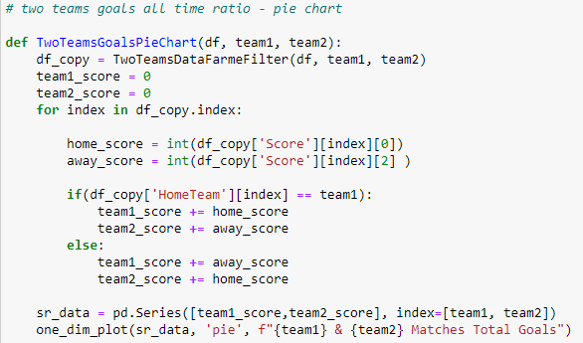
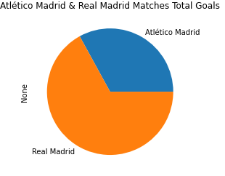
Two team – goals compare

Slide 15
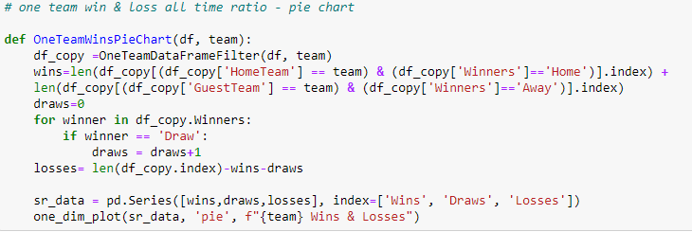
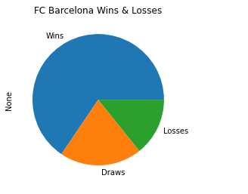
One team – win / loss / draw ratio

Slide 16
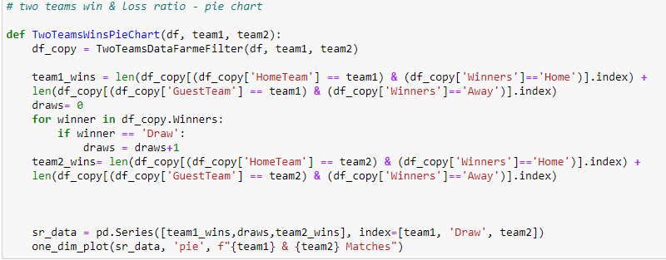
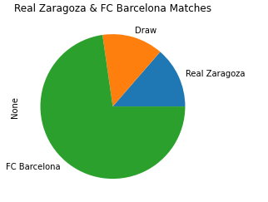
Two teams – win / draw ratio

Slide 17

Machine learning (logistic regression)

Slide 18
Why logistic regression?
Research question
Can we predict by analysis data from past which football team will win in a match ?
At first, we tired to use linear regression as type of machine learning but when we check our results, they was inconclusive. So, after rethinking we decided to use logistic regression and our results get much better.

Slide 19
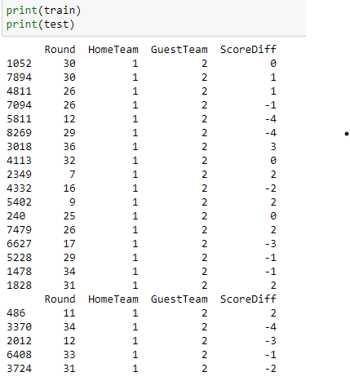
The data frame we used ML over

Slide 20
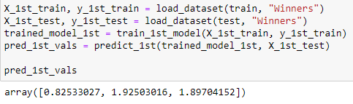
Linear regression try
We expected our result will be : 1 – if the home team will win. 2 - if the away team will win. 0 – if the match will end with draw.
At this point we understand that linear regression won’t help us to get our conclusion.

Slide 21
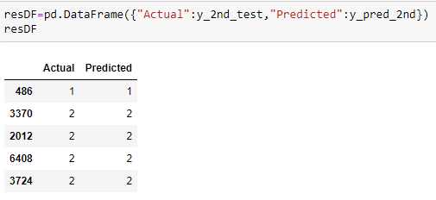
Logistic regression try
We expected our result will be : 1 – if the home team will win. 2 - if the away team will win. 0 – if the match will end with draw.

Slide 22
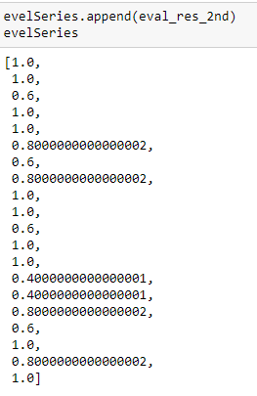
Linear regression conclusion
Now our result are much impressive. But its look to good to be true so we run this 20 times using f1_score to check are evaluate value. And we put the result in series, and this is the final result .
20 trials : 10 – times everything was correct 4 – times one mistake 4 – times two mistakes 2 – times three mistakes

Slide 23


Thank You
Eden Meshulam Daniel George

